Slide 1
Bayesian techniques

Slide 2
Multinest for Nemesis
Introduction
How to use it
Applications:
Jake
Jo
Josh
Jean-Loup

Slide 3
MultiNest for NEMESIS:
An intro to ellipsoidal nested sampling with NEMESIS, including examples and installation
Ryan Garland
&
Prof. Patrick G.J. Irwin

Slide 4
Part One:
An introduction to
Nested Sampling & MultiNest

Slide 5
WHY NESTED SAMPLING? BACKGROUND ON OPTIMAL ESTIMATION
NEMESIS by default uses optimal estimation as its inverse method. This is an extremely efficient inverse method, if your prior is close to your true answer.
However, a large range of priors must be investigated to ensure your solution is not degenerate.This includes creating a grid of priors with means and (co)variances of each parameter which are largely unknown. There is always the chance that parameter space is not fully explored, and the converged solution is not the best fit to the data.
As well as this prior grinding issue, OE assumes that all errors are Gaussian, which is not necessarily the case.

Slide 6
WHY NESTED SAMPLING? BACKGROUND ON OPTIMAL ESTIMATION
Prior far from true solution
Prior close to true solution

Slide 7
WHY NESTED SAMPLING? AN INTRO
Nested Sampling is an inverse method which
calculates the Bayesian evidence by sampling the posterior distribution, and produces probability distribution functions for each parameter as a by-product.
does not assume anything about the shape of the probability distributions (OE assumes Gaussian)
it fully explores parameter space (no more prior gridding)
fully explores all degenerate solutions (multi-modal solutions now possible)
automatically calculates the Bayesian evidence (can directly compare two different models, and which model is more appropriate when taking into account the number of free parameters in the model)

Slide 8
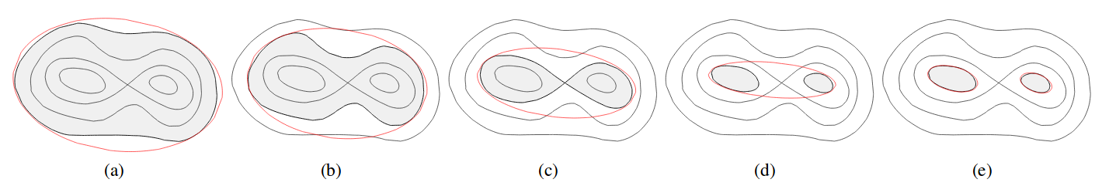
WHAT iS MULTINEST? THE ALGORITHM
MultiNest is a simultaneous ellipsoidal nested sampling algorithm. In plain English, the procedure of the algorithm goes like this:
Set up a range for your parameters (a uniform prior). For example, logVMR of H2O is between [-10,-1].
Normalise all of these ranges to be between 0 and 1. This creates a unit hypercube in parameter space. (N-dimensional cube with x,y,z etc between 0 and 1).
Run MultiNest. It uniformly samples the hypercube with ‘live points’ (state vectors), and fits a bounding ellipsoid around these points.
Checks are made to see if the posterior is multi-modal, and if this is true a k-means algorithm in applied recursively to split the ellipsoid into pairs of ellipsoids. (See Figure)
An associated spectrum is calculated with each live point, and compared to the data to calculate a probability (like a chi-squared).
The lowest probability live point is removed. A new live point is created, and a new bounding ellipsoid is calculated. Repeat from step 4.
Ends once a convergence criterion is met (change in Bayesian log-evidence 0.1).

Slide 9
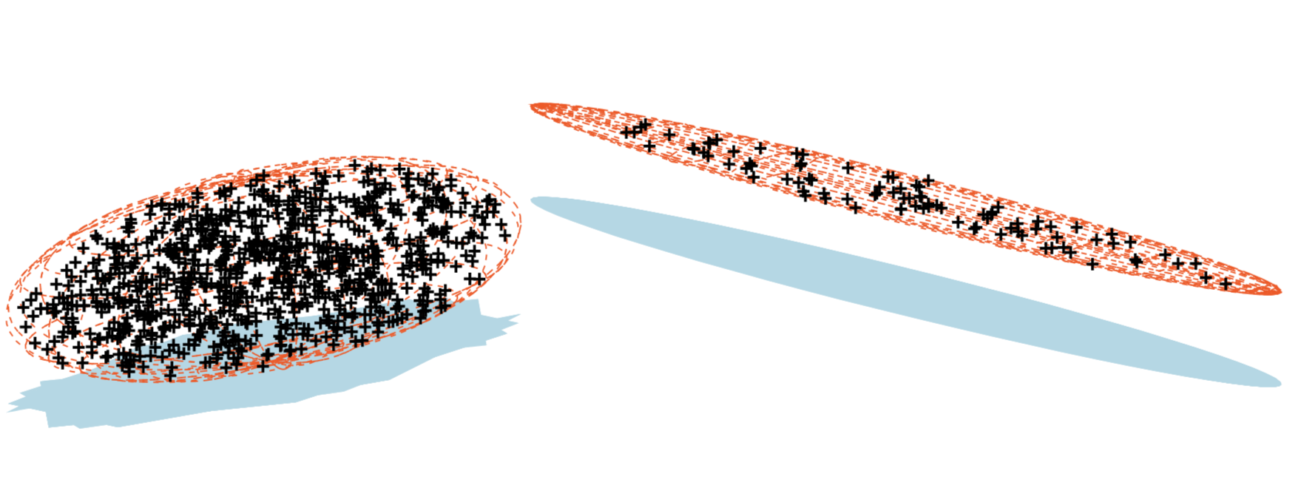
WHAT iS MULTINEST? MULTIMODAL POSTERIOR

Slide 10
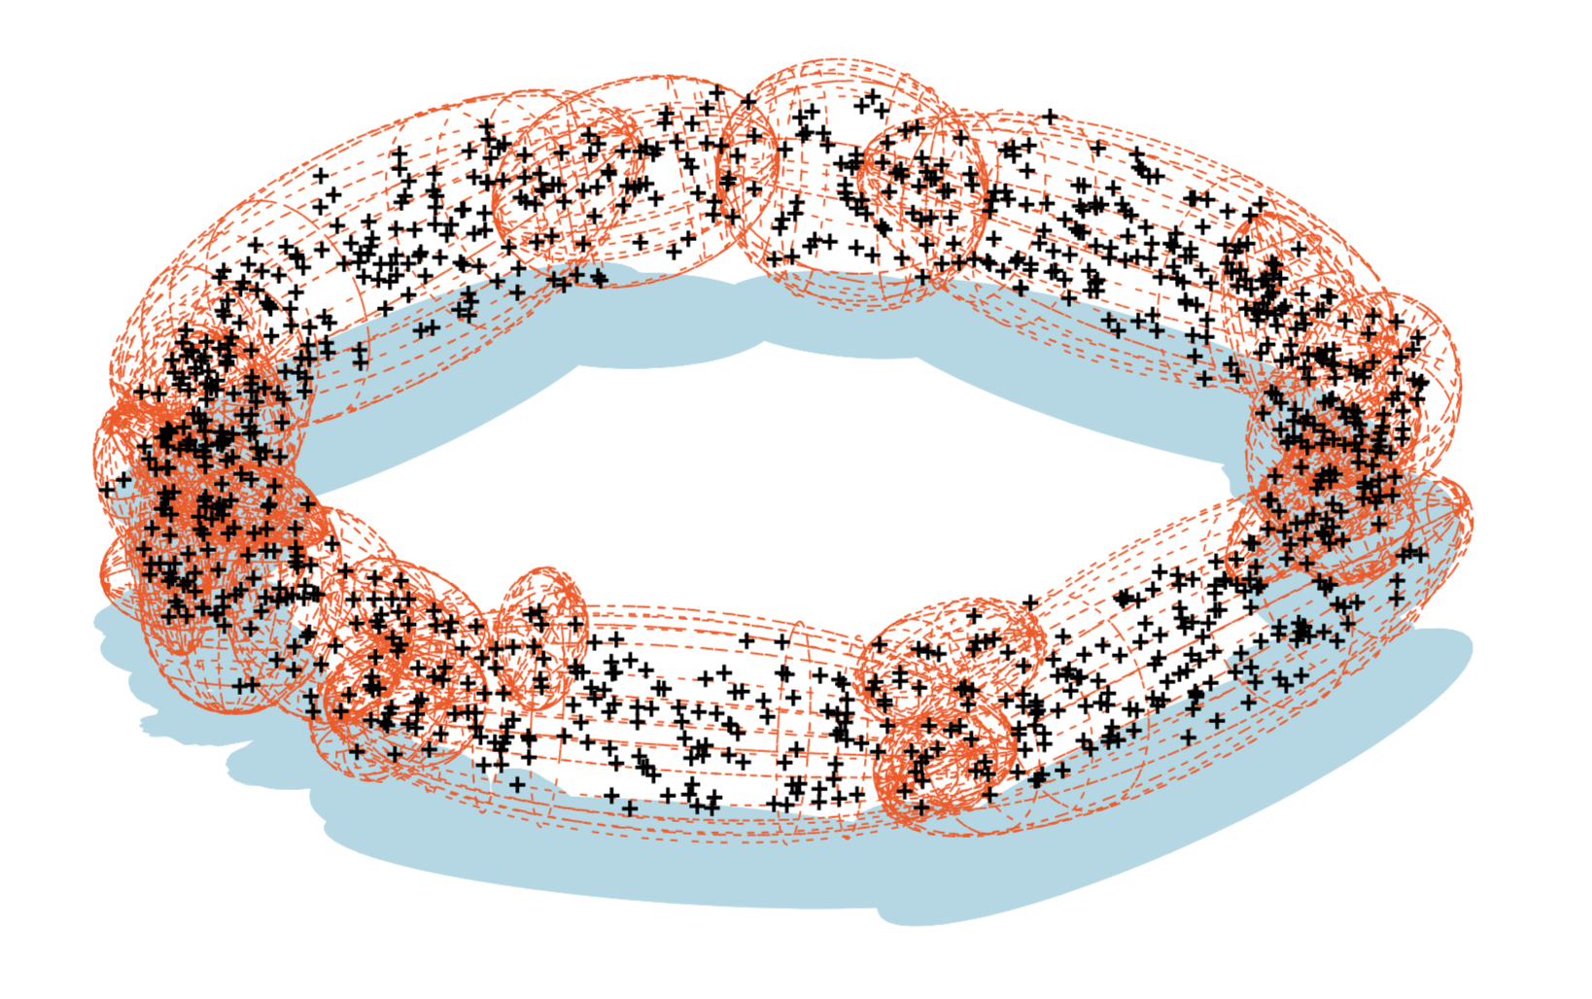
WHAT iS MULTINEST? TOROIDAL POSTERIOR

Slide 11
Part Two:
MultiNest & NEMESIS:
What MultiNest can do for you

Slide 12
WHAT iS MULTINEST? AN INTRO BY EXAMPLE: BROWN DWARF
3D Slice of
17D Hypercube
Data (Near-Infrared Spectrum)
H2O
CH4
NH3

Slide 13
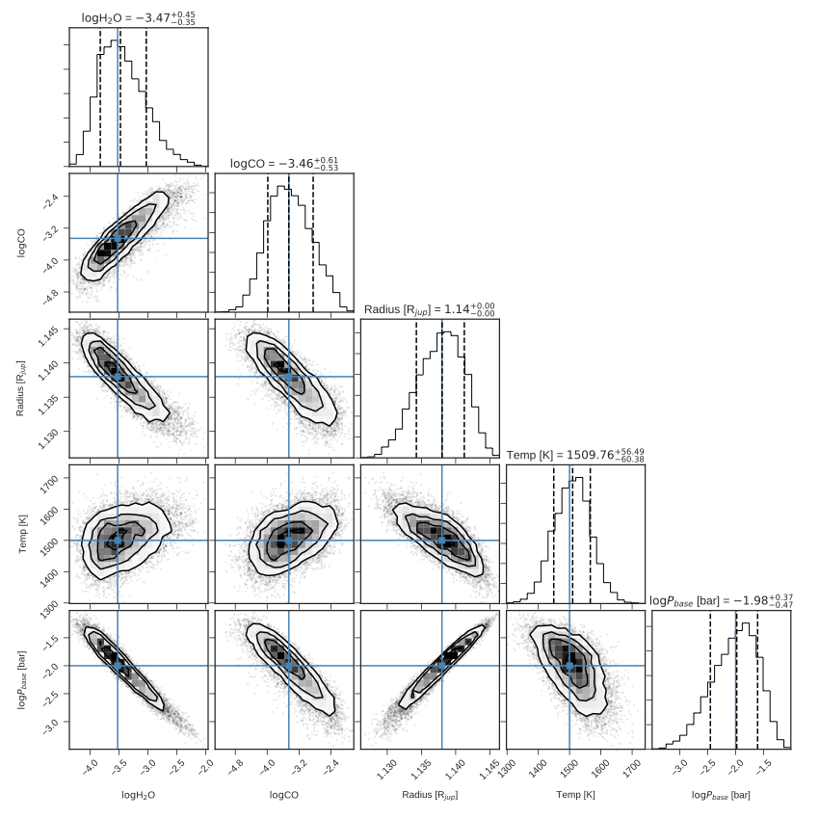
MULTINEST RESULTS: AN INTRO BY EXAMPLE: Primary TRANSIT FAKE DATA

Slide 14
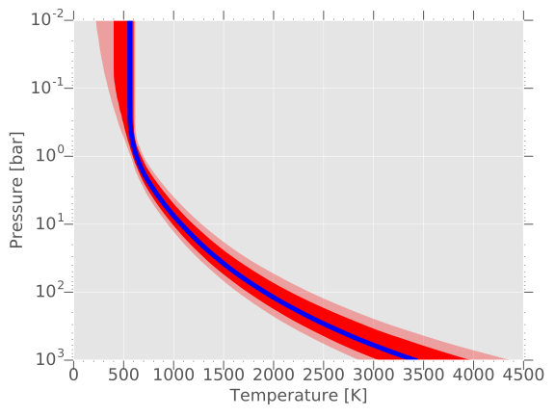
MULTINEST RESULTS: TEMPERATURE PROFILE
Median 1 Sig.
2 Sig.

Slide 15
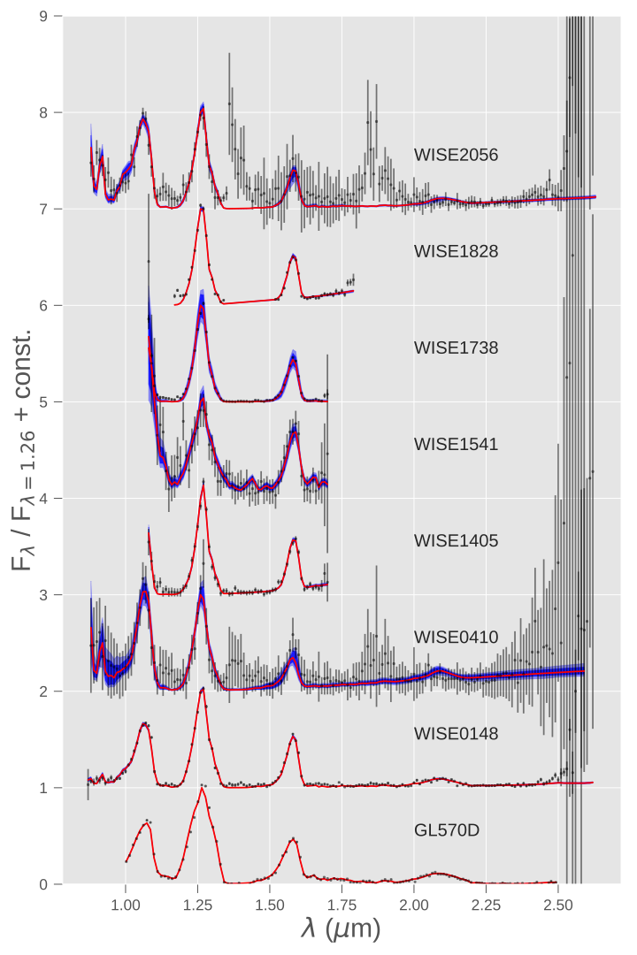
MULTINEST RESULTS:
Spectral fits OF
BROWN DWARFS
Data Median
1 Sig. 2 Sig.

Slide 16
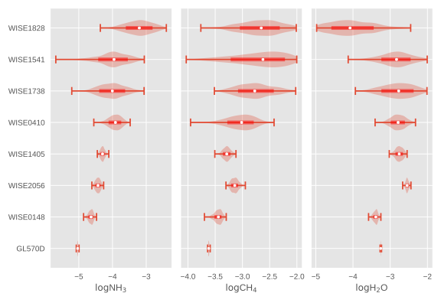
MULTINEST RESULTS: COMPARING POSTERIORS
>Y2
Prob.
Median
<—1 Sigma—>
T8
<———————Extrema————>
log10NH3
log10CH4
log10H2O

Slide 17
MULTINEST USERGUIDE: INSTALLATION
Download latest git version of radtrancode.
External: follow https://johannesbuchner.github.io/PyMultiNest/install.html
Internal: add my LD_LIBRARY_PATH to your .tcshrc file. Also add: module load pymods_trusty to .tcshrc.
Go to Nemesis subfolder in radtrancode, and type e.g.: source nemesisPyMult.comp to create the nemesisPyMult.so shared object file (basically a python library you can import). Do the same for nemesisPT_NS.comp, and any other versions you’d like.
Next is to use the compiled file!

Slide 18
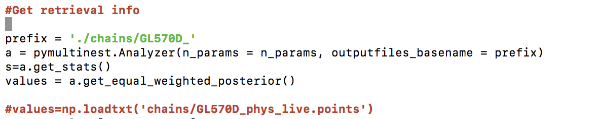

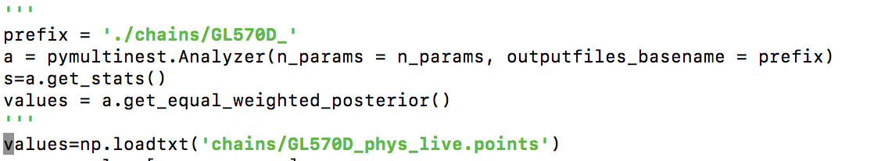
MULTINEST USERGUIDE: SETUP
Create a normal Nemesis folder with all the relevant inputs, as for OE
Switch the number of iterations to -1, and set the .apr file to have zero parameters (*clouds are included in the .apr file, if you wish to have them)
Take these files, and duplicate them so that there are 64 folders (or however many cores you will use), numbered from 0-63. Also create a 999 folder, which is used for plotting.
In the directory containing all of these duplicate folders, copy the .so file from the Nemesis subfolder.
Setup your retrieval in python (see NS_ret.py for example usage) i.e. your forward model and associated hypercube
Run the retrieval (64 is core number, unnecessary text being redirected to trash) with: mpiexec -n 64 python NS_ret.py > /dev/null &
Either wait until the whole retrieval is finished and use NS_plot.py, or modify it slightly to watch convergence occur while the retrieval runs. The modification is done like so (note the triple quotes):

Slide 19
MULTINEST USERGUIDE: NOTES
Temperature and VMRs are passed through with the same number of layers as in the .ref file.
The VMRs must be in the same order as the .ref file. Must sum to 1.0
Mass and radius are in terms of Jupiter, so a 1.0 radius is 69111km
The aforementioned parameters are always passed, as well as pressure, and height (though NEMESIS recalculates height anyway, only the base height is important (0.0 km)).

Slide 20
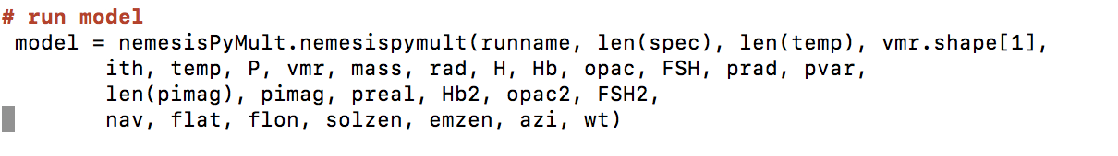
MULTINEST USERGUIDE: PARAMETERS
1. runname: name of nemesis files, e.g. ‘jupiter’ for jupiter.ref.
2. len(spec) = length of spectrum, number of points in .spx file.
3. len(temp) = number of pressure points in .ref.
4. vmr.shape[1] = number of gases in .ref file.
5. ith = i^{th} directory to perform calculation in. Linked to which core is being used.
6. Temp = temperature profile
7. P = pressure profile
8. vmr = vmr profile for all gases
9. Mass = mass in jupiter masses
10. Rad = radius in jupiter radii
11. H = height profile
12. Hb = base height of cloud in km (used for cloud parameterisation #9)
13. Opac = integrated optical depth at specified wavelength (#9)
14. FSH = fractional scale height (#9)
15. prad = particle radius in microns (cloud param #444)
16. pvar = particle size variance in microns (cloud param #444)
17. len(pimag) = number of imaginary indices from refractive index
18. Pimag = imaginary refractive index spectrum
19. PReal = real refractive index at specified wavelength
20. Hb2 = second cloud #9
21. opac2
22. FSH2
23. Nav = number of averaging weights in .spx file
24. Flat = latitudes of weights
25. Flon = longitude of weights
26. Solzen = solar zenith angle
27. Emzen = emission zenith
28. Azi = azimuthal angle
29. Wt = weights

Slide 21
MULTINEST USERGUIDE: PARAMETERS
1. runname: name of nemesis files, e.g. ‘jupiter’ for jupiter.ref.
2. len(spec) = length of spectrum, number of points in .spx file.
3. len(temp) = number of pressure points in .ref.
4. vmr.shape[1] = number of gases in .ref file.
5. ith = i^{th} directory to perform calculation in. Linked to which core is being used.
6. Temp = temperature profile
7. P = pressure profile
8. vmr = vmr profile for all gases
9. Mass = mass in jupiter masses
10. Rad = radius in jupiter radii
11. H = height profile
12. Hb = base height of cloud in km (used for cloud parameterisation #9)
13. Opac = integrated optical depth at specified wavelength (#9)
14. FSH = fractional scale height (#9)
15. prad = particle radius in microns (cloud param #444)
16. pvar = particle size variance in microns (cloud param #444)
17. len(pimag) = number of imaginary indices from refractive index
18. Pimag = imaginary refractive index spectrum
19. PReal = real refractive index at specified wavelength
20. Hb2 = second cloud #9
21. opac2
22. FSH2
23. Nav = number of averaging weights in .spx file
24. Flat = latitudes of weights
25. Flon = longitude of weights
26. Solzen = solar zenith angle
27. Emzen = emission zenith
28. Azi = azimuthal angle
29. Wt = weights
Compulsory parameters

Slide 22
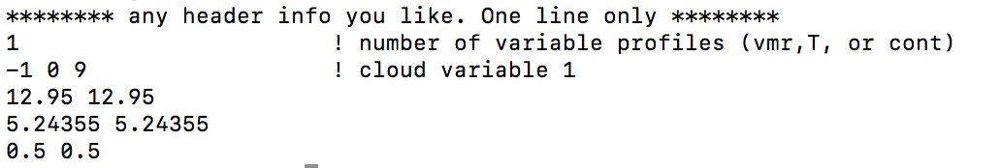
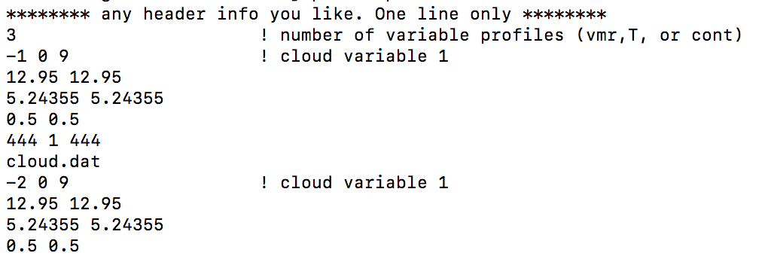
MULTINEST USERGUIDE: PARAMETERS
1. runname: name of nemesis files, e.g. ‘jupiter’ for jupiter.ref.
2. len(spec) = length of spectrum, number of points in .spx file.
3. len(temp) = number of pressure points in .ref.
4. vmr.shape[1] = number of gases in .ref file.
5. ith = i^{th} directory to perform calculation in. Linked to which core is being used.
6. Temp = temperature profile
7. P = pressure profile
8. vmr = vmr profile for all gases
9. Mass = mass in jupiter masses
10. Rad = radius in jupiter radii
11. H = height profile
12. Hb = base height of cloud in km (used for cloud parameterisation #9)
13. Opac = integrated optical depth at specified wavelength (#9)
14. FSH = fractional scale height (#9)
15. prad = particle radius in microns (cloud param #444)
16. pvar = particle size variance in microns (cloud param #444)
17. len(pimag) = number of imaginary indices from refractive index
18. Pimag = imaginary refractive index spectrum
19. PReal = real refractive index at specified wavelength
20. Hb2 = second cloud #9
21. opac2
22. FSH2
23. Nav = number of averaging weights in .spx file
24. Flat = latitudes of weights
25. Flon = longitude of weights
26. Solzen = solar zenith angle
27. Emzen = emission zenith
28. Azi = azimuthal angle
29. Wt = weights
Cloud parameters are read in IF the appropriate .apr parameters have been inserted.
If .apr is empty, then any placeholder values can be used as the clouds are not included in the retrieval.

Slide 23
MULTINEST USERGUIDE: PARAMETERS
1. runname: name of nemesis files, e.g. ‘jupiter’ for jupiter.ref.
2. len(spec) = length of spectrum, number of points in .spx file.
3. len(temp) = number of pressure points in .ref.
4. vmr.shape[1] = number of gases in .ref file.
5. ith = i^{th} directory to perform calculation in. Linked to which core is being used.
6. Temp = temperature profile
7. P = pressure profile
8. vmr = vmr profile for all gases
9. Mass = mass in jupiter masses
10. Rad = radius in jupiter radii
11. H = height profile
12. Hb = base height of cloud in km (used for cloud parameterisation #9)
13. Opac = integrated optical depth at specified wavelength (#9)
14. FSH = fractional scale height (#9)
15. prad = particle radius in microns (cloud param #444)
16. pvar = particle size variance in microns (cloud param #444)
17. len(pimag) = number of imaginary indices from refractive index
18. Pimag = imaginary refractive index spectrum
19. PReal = real refractive index at specified wavelength
20. Hb2 = second cloud #9
21. opac2
22. FSH2
23. Nav = number of averaging weights in .spx file
24. Flat = latitudes of weights
25. Flon = longitude of weights
26. Solzen = solar zenith angle
27. Emzen = emission zenith
28. Azi = azimuthal angle
29. Wt = weights
If nav = 0, then .spx file is used normally.
Otherwise, you can put in your own averaging weights.

Slide 24
MULTINEST USERGUIDE: EXAMPLES
Examples are given in ~garland/NS_EXAMPLES/
I suggest you follow the installation instructions, copy the BASIC_BD_RET example somewhere, copy in your new .so file, and then run as per instructions. Check out the plots from NS_plot, and see if they look sensible!

Slide 25
Teff
In exoplanet direct imaging a key parameter is effective temperature
Nemesis can retrieve TP profile but not the effective temperature if the observation are not covering a big wavelength range...
2 options:
Parametrise TP profile with a give Teff
Compute the full spectrum

Slide 26
Teff
Result of the Nested sampling on sparse data
Generation of spectra covering 0.3-30 microns
Integration of the flux over the wavelength range
Teff
Spectra
With the same sparse wavelength covering as the observations
output

Slide 27
Teff (limitation)
Result of the Nested sampling on sparse data
Generation of spectra covering 0.3-30 microns
Integration of the flux over the wavelength range
Teff
input
Molecules that are not with features in the observation wavelength range

Slide 28
Perspective
Currently you need to modify python codes in various location to change what your are retrieving
Goal: input file for the python code

Slide 29
Applications on extra solar objects

Slide 30
Application to Exoplanet Atmospheres Jake Taylor (@astrojake) University of Oxford

Slide 31
JWST
Project changed due to launch delay :(
What was the original plan?
Work with ERS data; transmission, eclipse and phase curve
Develop proposal with our own science goals

Slide 32
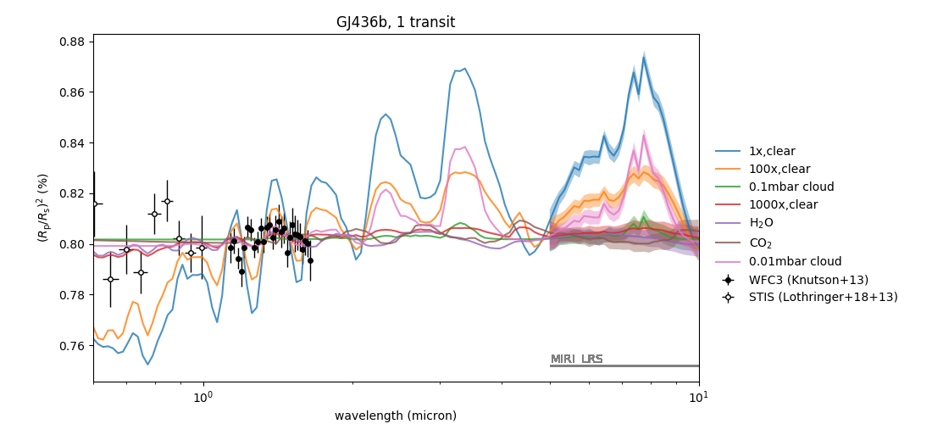
JWST

Slide 33
Ultra Hot Jupiters
Teff > 2000 K
Theorised to have temperature inversion (Hubeny+03,Fortney+08)
Recent observations have been inconclusive either finding no inversion (Madhusudhan+11), some finding inversions (Evans+17, Mansfield+18), and some finding blackbody spectrum is best fit (Crossfield+17,Parmentier+18)

Slide 34
WASP 121b
•Ultra Hot Jupiter orbiting just outside the Roche limit
•Effective temperature of ~ 2500K
•H2O, VO and TiO have been detected in its atmosphere
•Emission peak of H2O tells us there is a temperature inversion (Evans+17)

Slide 35
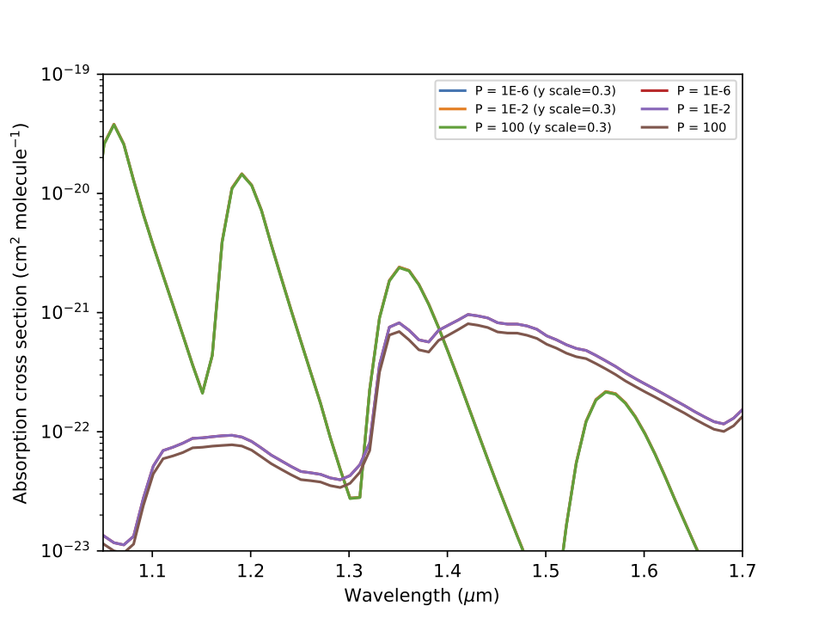
WASP 121b
K-tables range: 100 – 2950K (thanks Ryan!)
CIA range 200K – 3800K
NEMESIS is fit to analyse the object

Slide 36
WASP 121b
Issues with studying ultra Hot Jupiters with NEMESIS:
Objects are similar temperature regime to stellar atmospheres so need to consider new opacity sources
NS version of code current TP profile doesn't account for inversions, currently in progress.

Slide 37
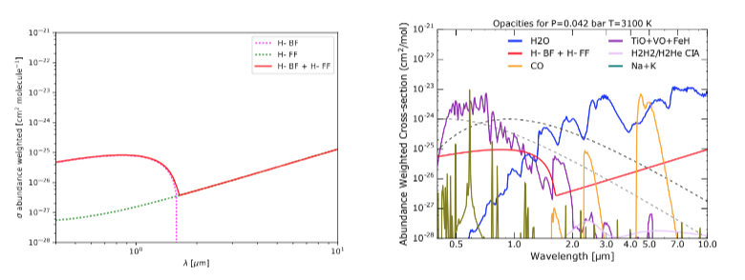
H- Opacity
Ionisation of metals in atmosphere generate electrons
H2 dissociates to 2H in high temperatures, electrons and H interact which cause H- opacity (Arcangeli+18)
Bell+78; John 88
Parmentier+18

Slide 38
Future/Goals
Perform retrievals with H- opacity and compare with published spectra to check correct implementation
Implement TP profile that can solve for inversions (currently TP profile is for non-irradiated planets)
Try to generalise python wrapper more, currently hardcoded

Slide 39
Extra solar terrestrial planets Joshua Krissansen-Totton University of Washington

Slide 40
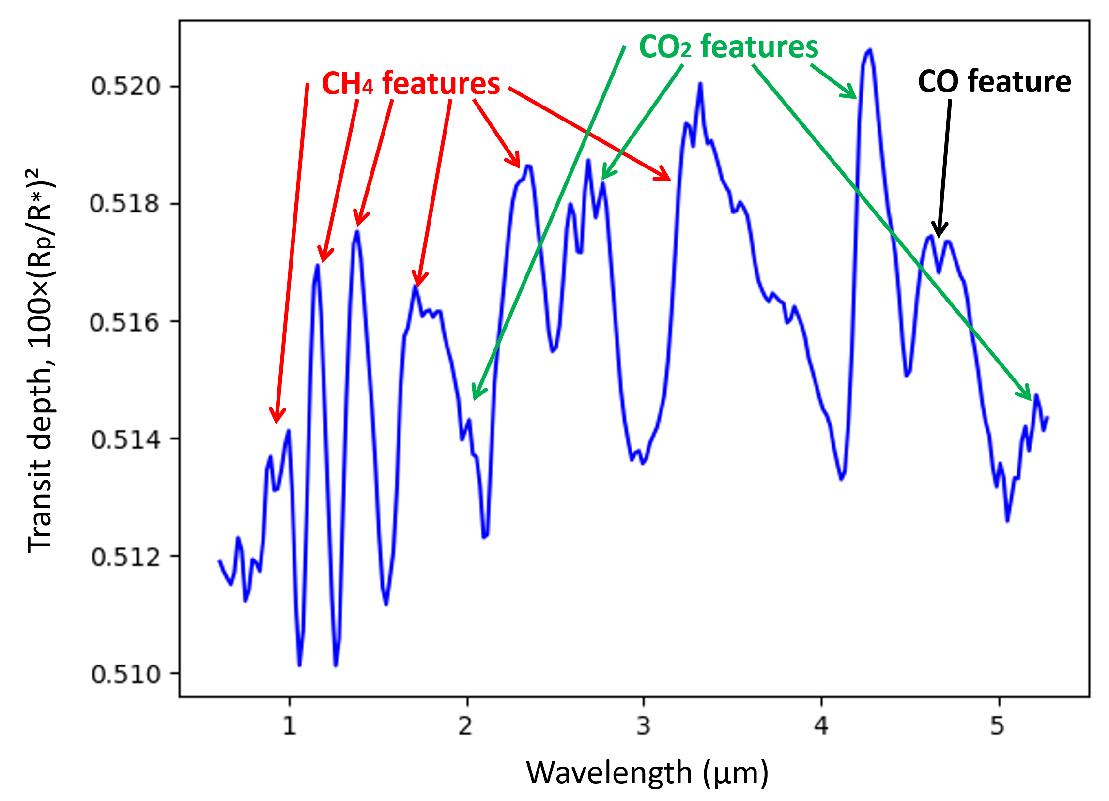
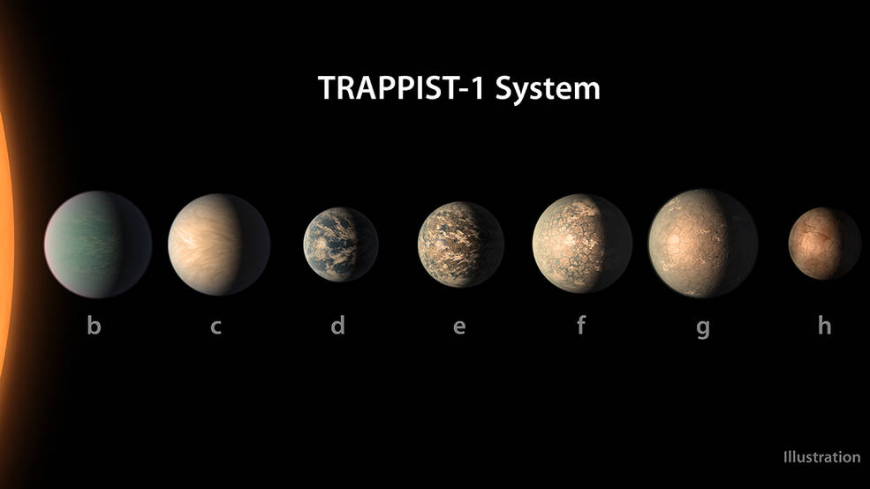
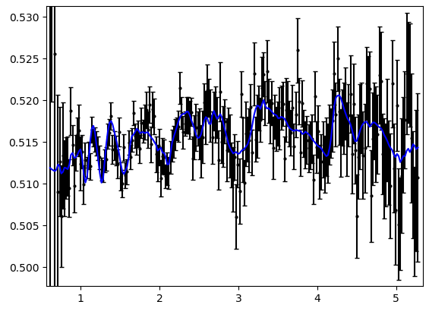
The inverse problem
Archean Earth-like composition (no haze)
Mass = 0.772 MEarth
Radius = 0.91 REarth
pCO2 = 5%
pCH4 = 0.5%
pCO = 0%
pH2O = 1%
T_strat = 200 K
P_surf = 1 bar
Forward model NEMESIS
Compare to “true” properties
Instrument simulator: PandExo described in Batalha et al. (2017) PASP
JWST simulator
Mass = 0.81±0.2 MEarth
Radius = 0.901±0.003 REarth
pCO2 = 3±2%
pCH4 = 0.3±0.29%
pCO = 0.001±0.0002%
pH2O = 0.5±0.48%
T_strat = 188±54 K
P_surf = 2.3±1.3 bar
Transit depth, 100×(Ap/As)
Solve inverse problem
Wavelength (μm)

Slide 41
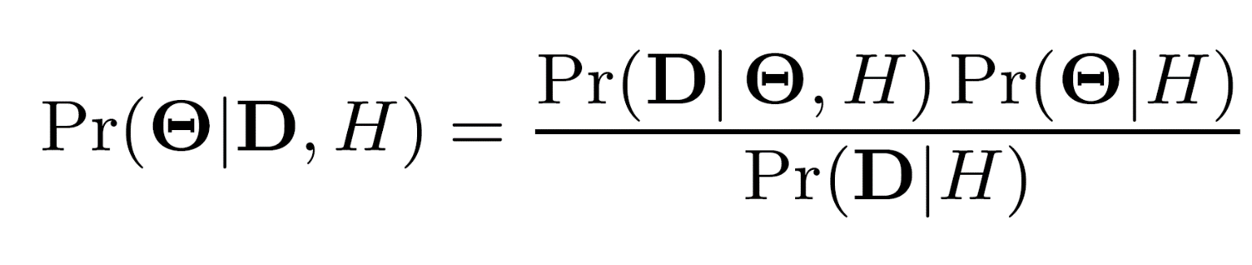
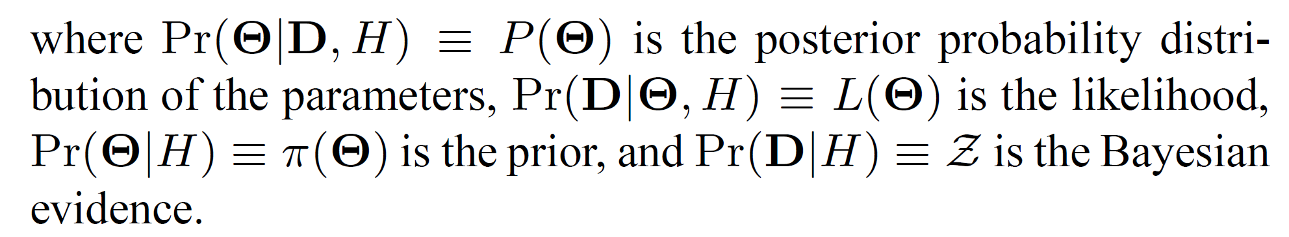

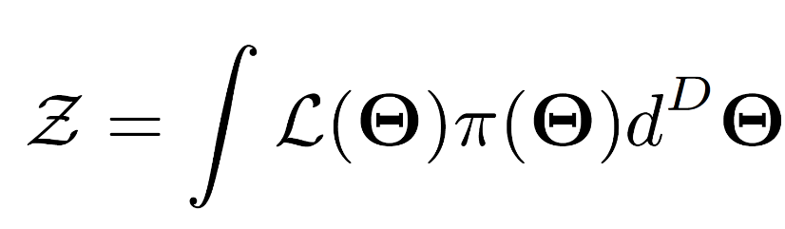
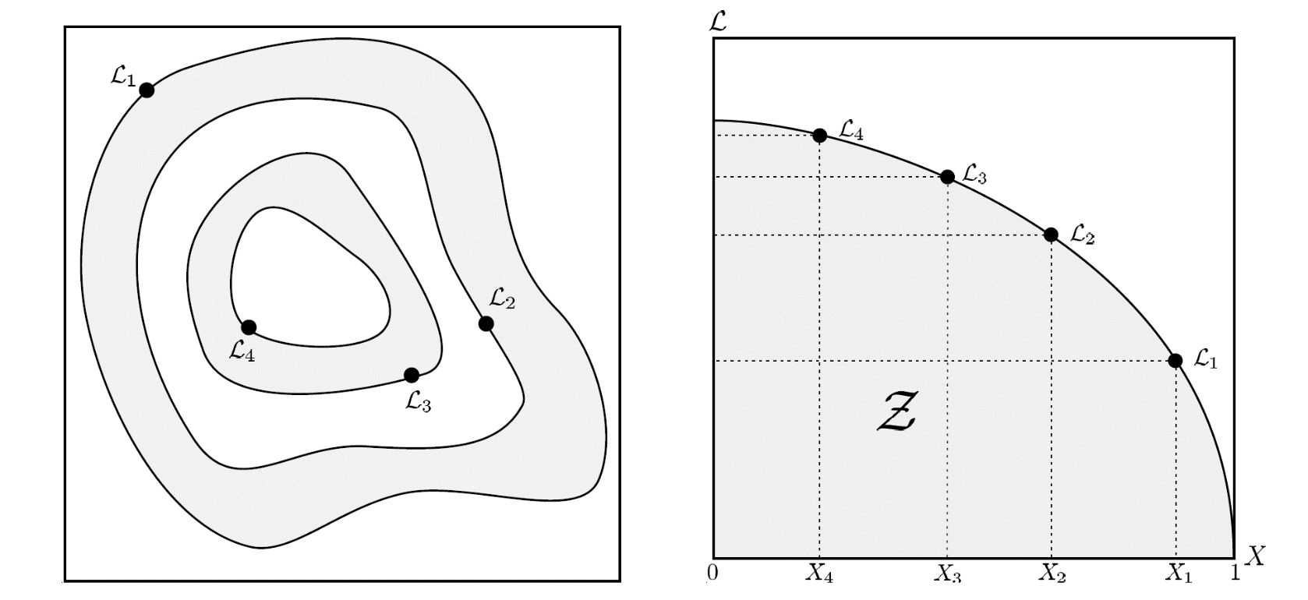
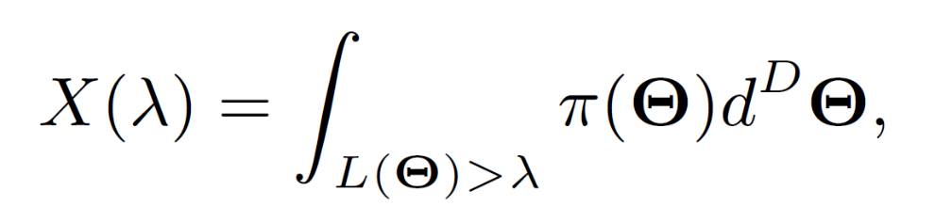
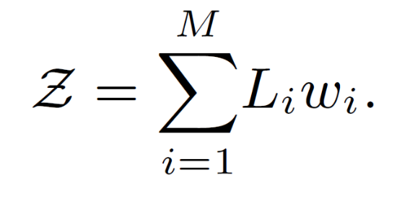
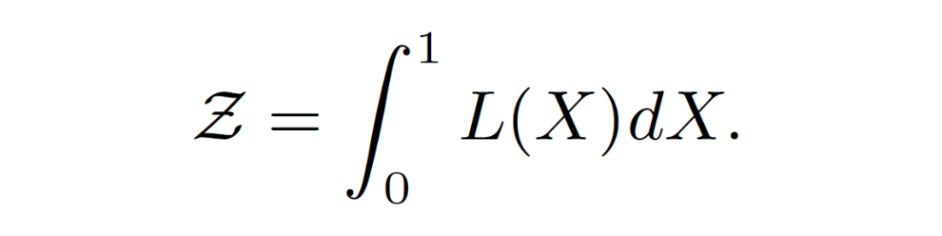
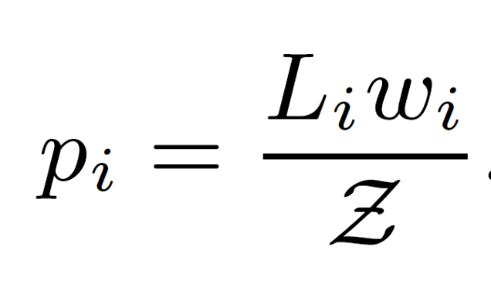
Nested Sampling Retrieval algorithm
Feroz and Hobson 2008, MNRAS
Transform this horrible integral into a 1D integral over prior volume:
Posteriors can then be easily calculated:
Can then calculate Bayesian evidence as summation over likelihood contours:
Nested Sampling Produces same posteriors as MCMC
Notes:
Start will full prior volume, calculate likelihood at set of points. Lowest likelihood point is removed, draw another. Move through likelihood contours until Bayesian evidence is no longer changing.

Slide 42
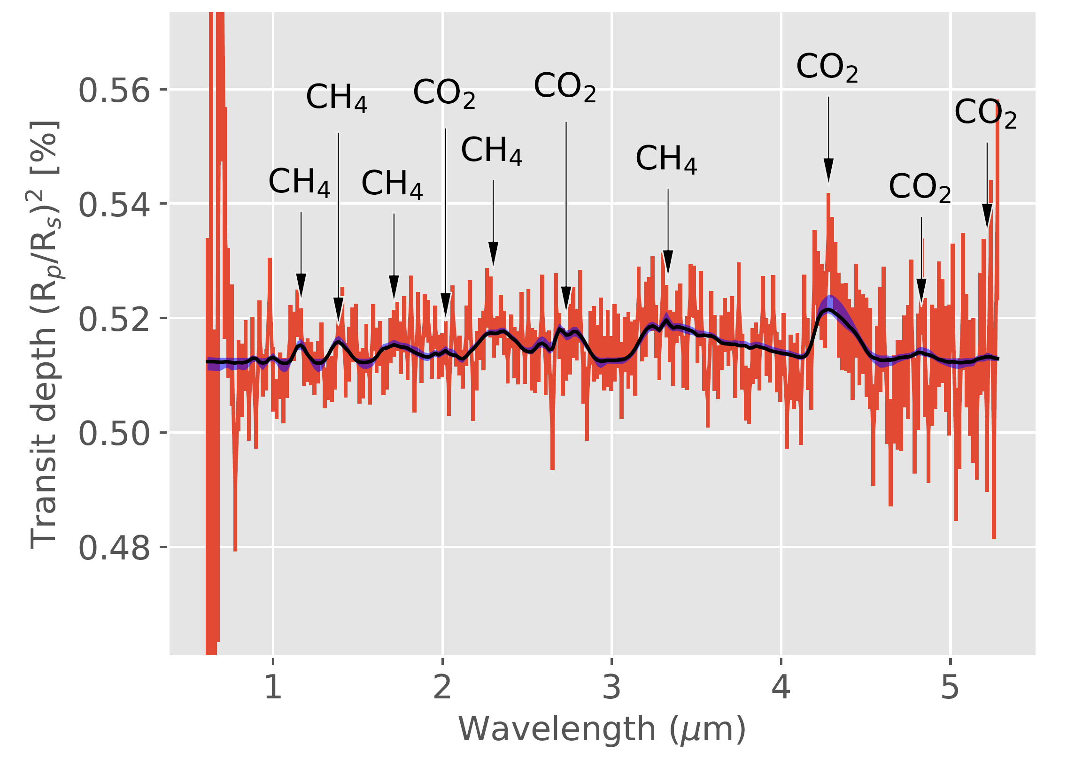
TRAPPIST-1e, NIRSpec prism on JWST, 10 transits
J. Krissansen-Totton, R. Garland, P. Irwin & D. C. Catling. Detectability of biosignatures in anoxic atmospheres with the James Webb Space Telescope: A TRAPPIST-1e case study, submitted to Astronomical Journal, 2018.

Slide 43
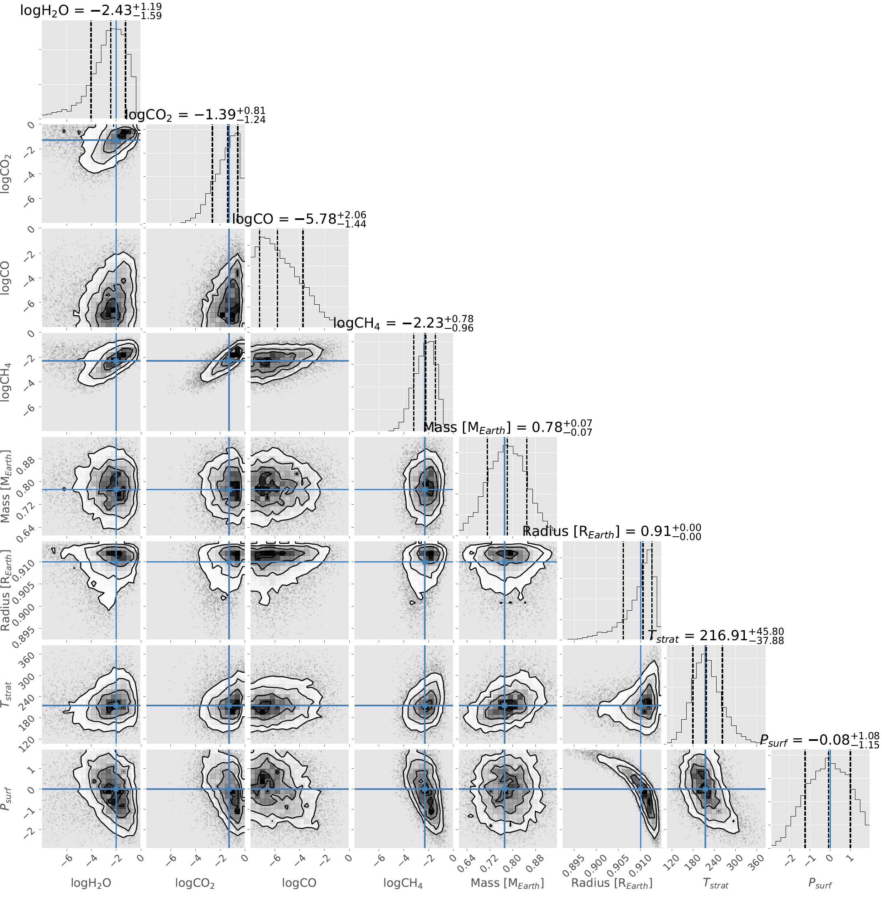
TRAPPIST-1e, NIRSpec prism on JWST, 10 transits
CH4 and CO2 are detectable for an early Earth-like TRAPPIST-1e
CH4 abundance can be constrained well enough to rule out non-biological production.
CH4/CO2 biosignature easier to detect than biological O3/O2 (next slide).
J. Krissansen-Totton, R. Garland, P. Irwin & D. C. Catling. Detectability of biosignatures in anoxic atmospheres with the James Webb Space Telescope: A TRAPPIST-1e case study, submitted to Astronomical Journal, 2018.

Slide 44
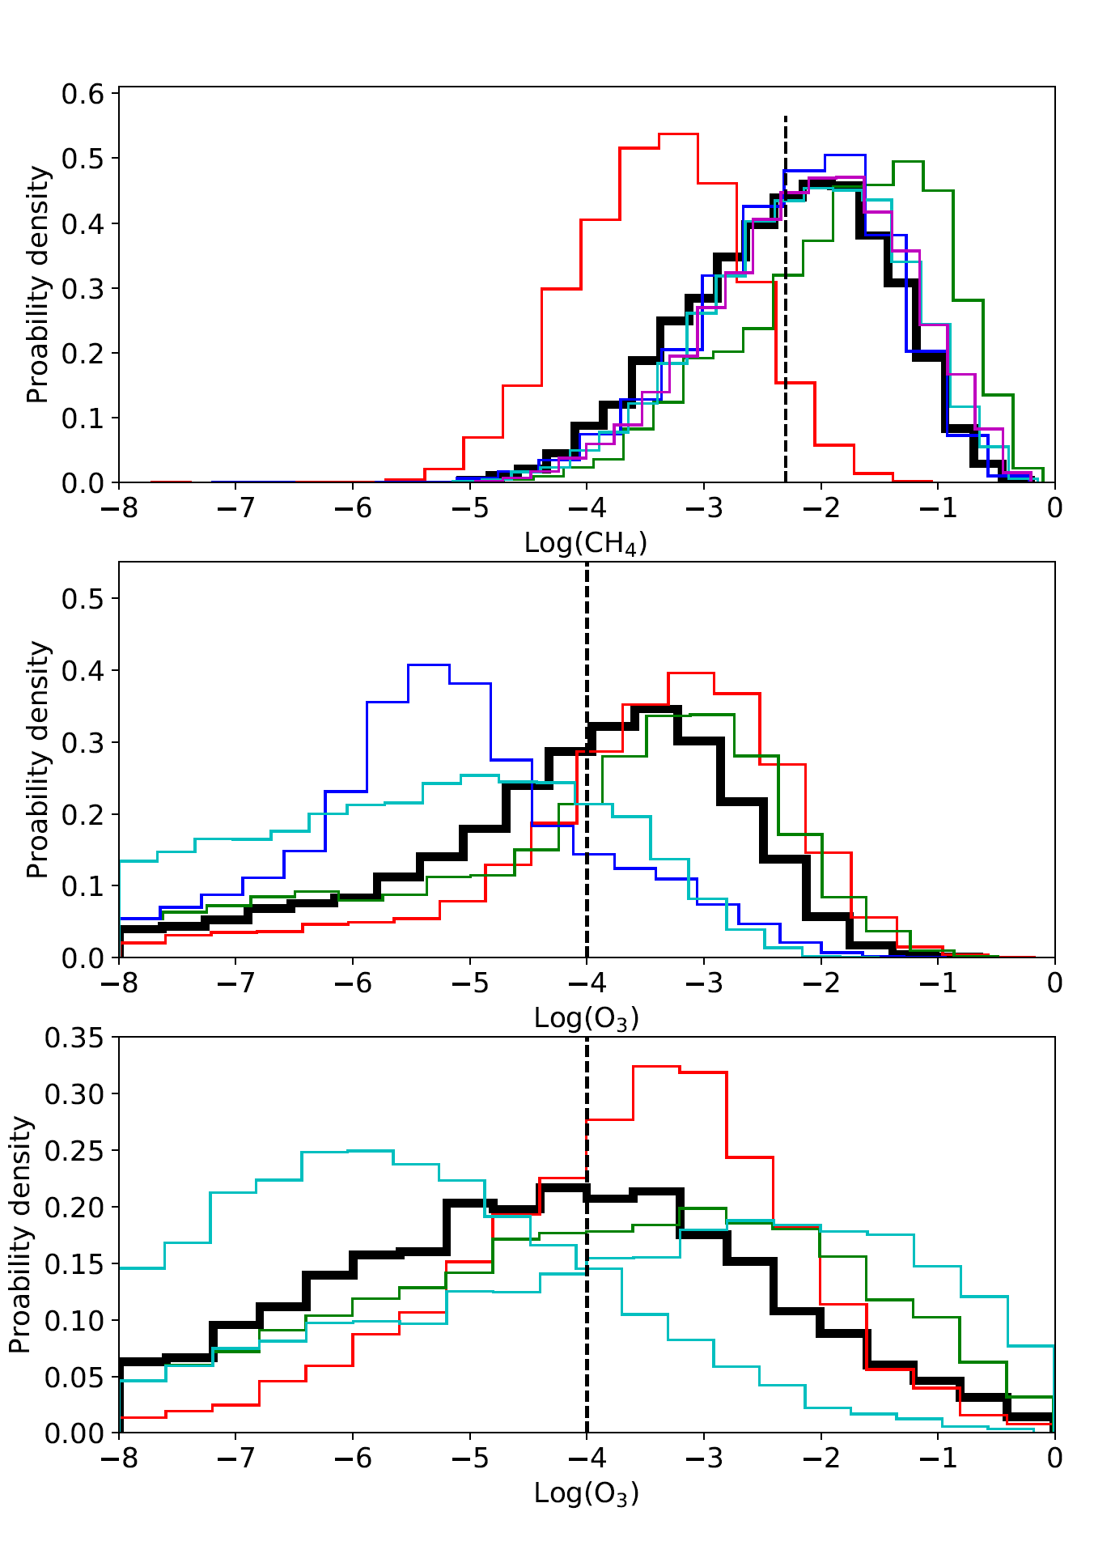
TRAPPIST-1e 10 transits
CH4 posteriors for early Earth-like TRAPPIST-1e observed with NIRSpec prism. Biological CH4 is detectable.
O3 posteriors for modern Earth-like TRAPPIST-1e observed with NIRSpec prism. Biological O3 is NOT detectable.
O3 posteriors for modern Earth-like TRAPPIST-1e observed with MIRI LRS. Biological O3 is NOT detectable.
J. Krissansen-Totton, R. Garland, P. Irwin & D. C. Catling. Detectability of biosignatures in anoxic atmospheres with the James Webb Space Telescope: A TRAPPIST-1e case study, submitted to Astronomical Journal, 2018.

Slide 45
Extra solar giant planets observed with SPHERE Jean-Loup Baudino University of Oxford

Slide 46
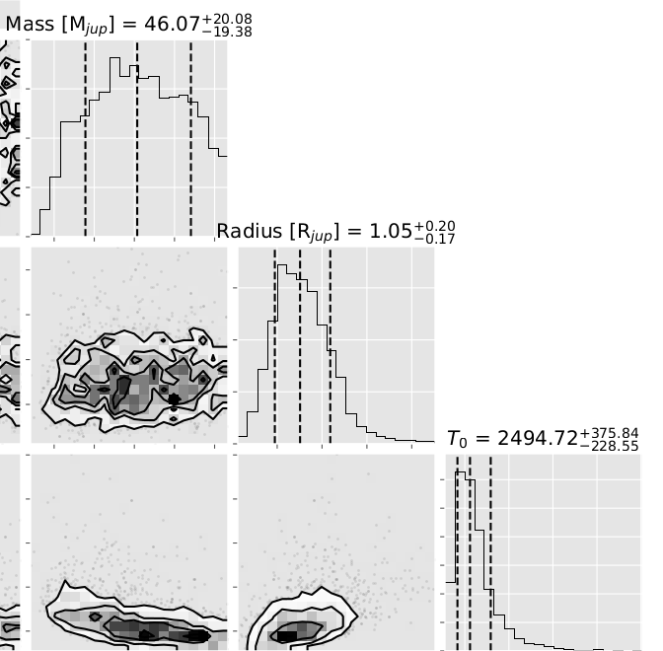
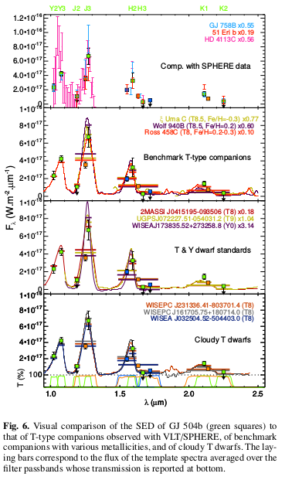
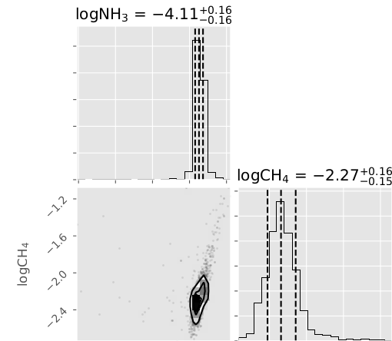
GJ 504
Bonnefoy et al. submitted

Slide 47
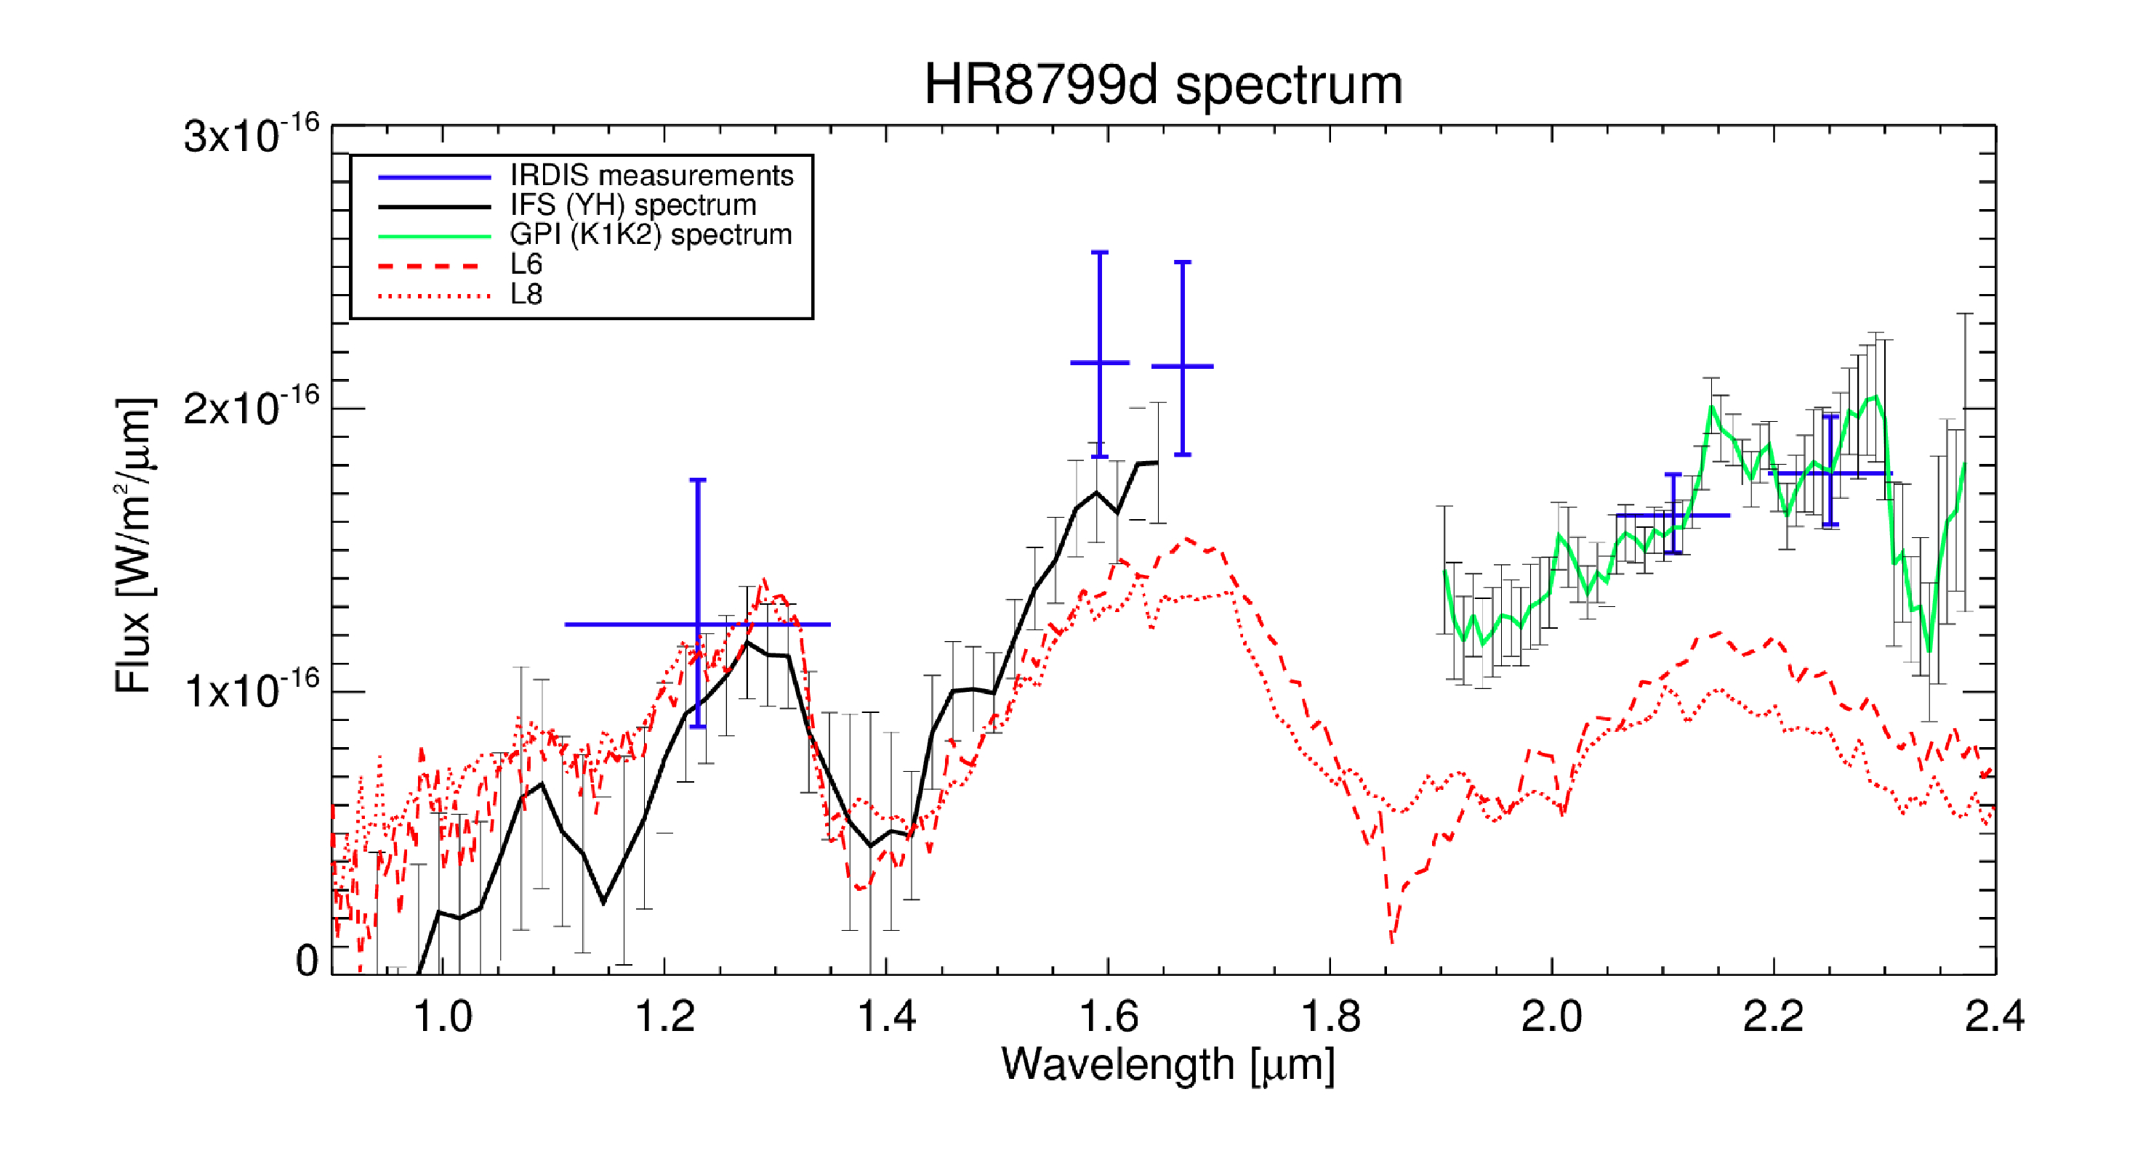
HR8799 SPHERE observations
Zurlo et al. A&A 2016

Slide 48
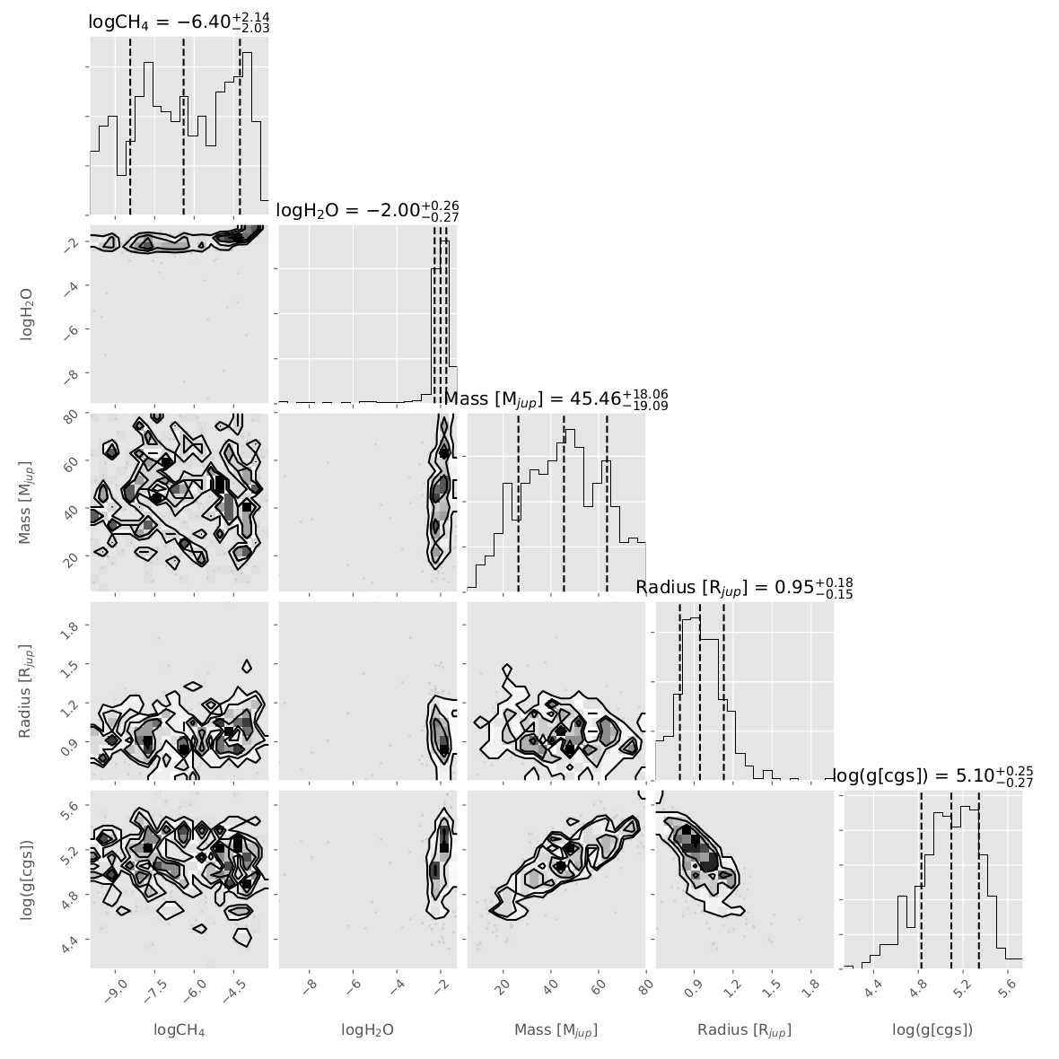
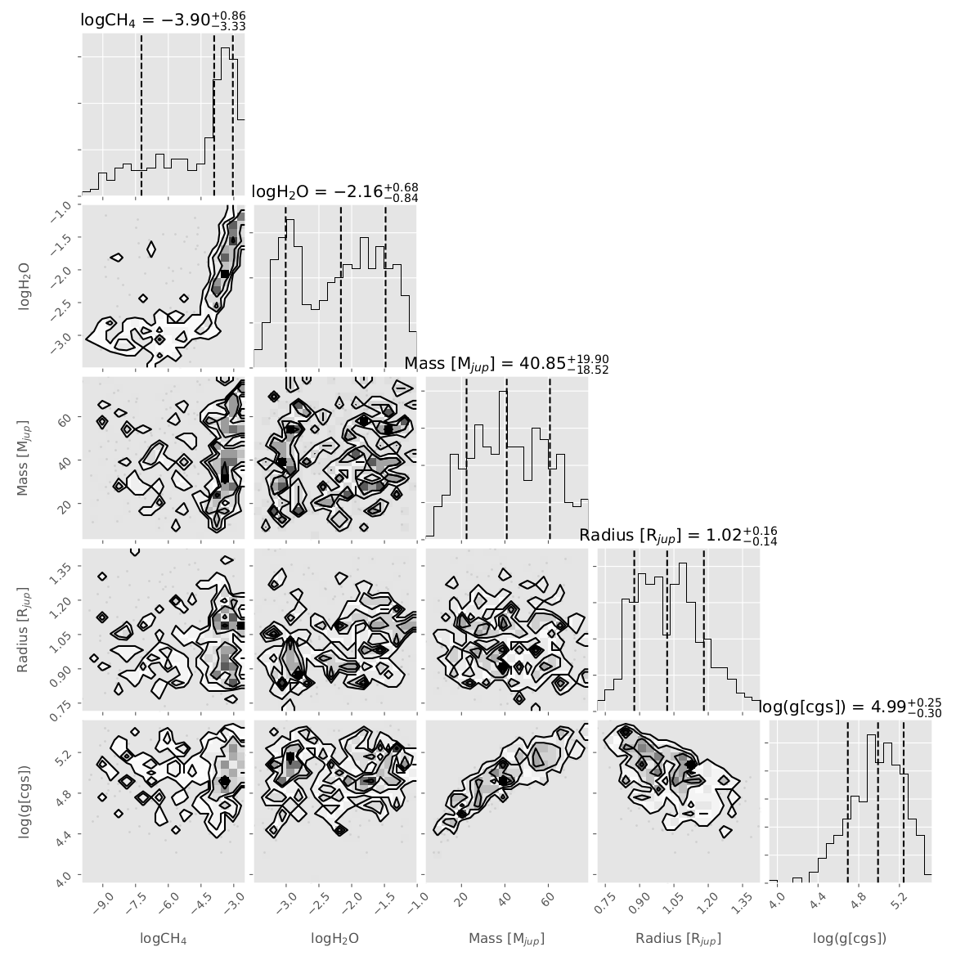
HR8799
Baudino et al. in prep

Slide 49
Hot Jupiters in transmission Joanna Barstow (@DrJoVian) University College London

Slide 50
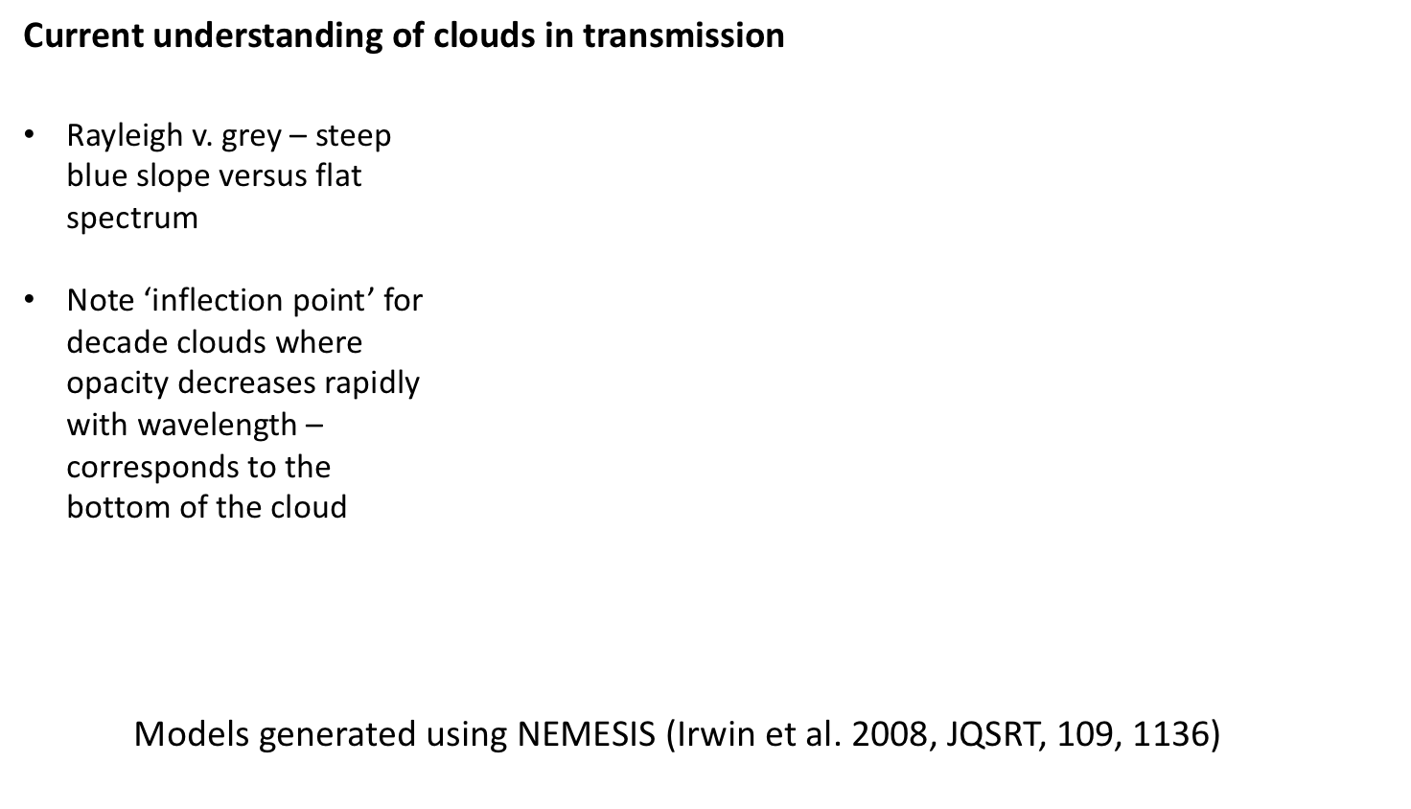
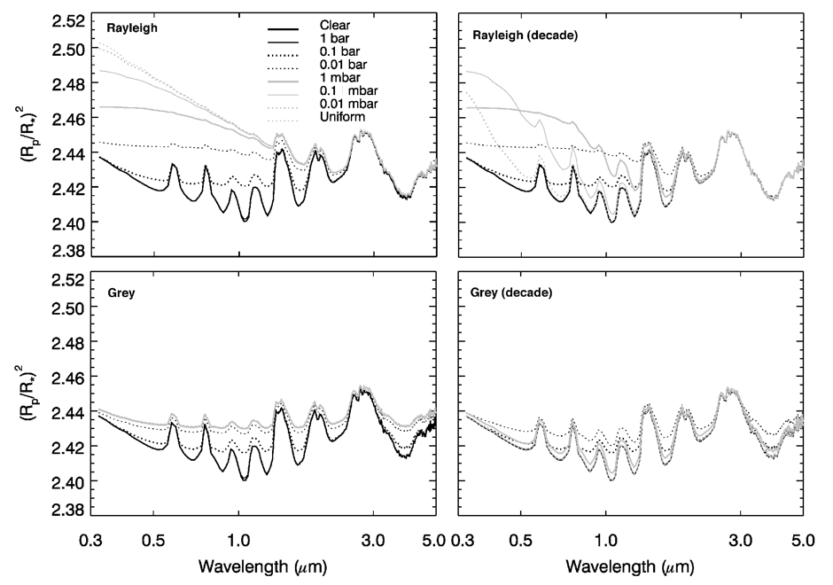

Slide 51
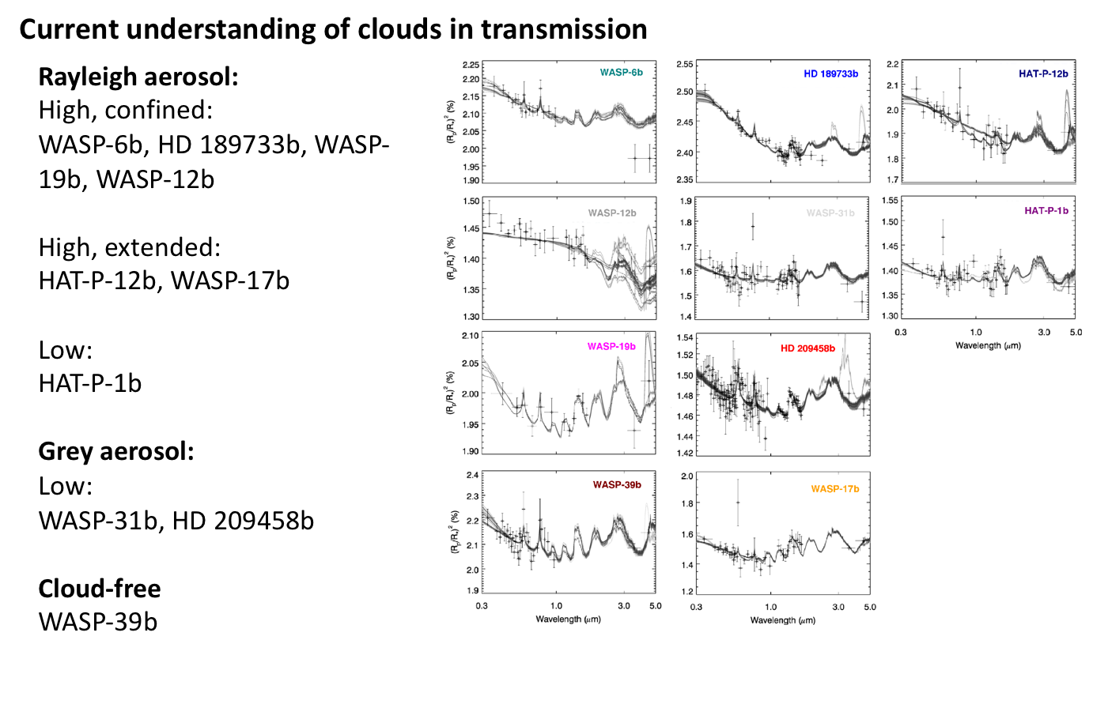
Barstow et al. 2017
Bracketed retrieval: issues – how to manage uncertainties? Model dependence?
- MultiNest might help!

Slide 52

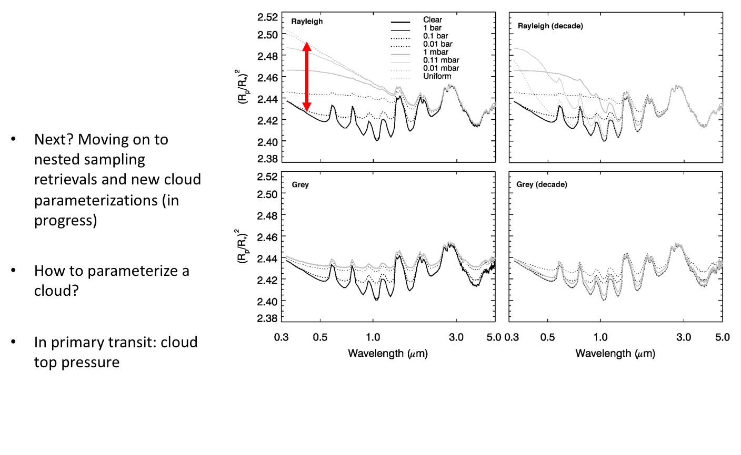

Slide 53
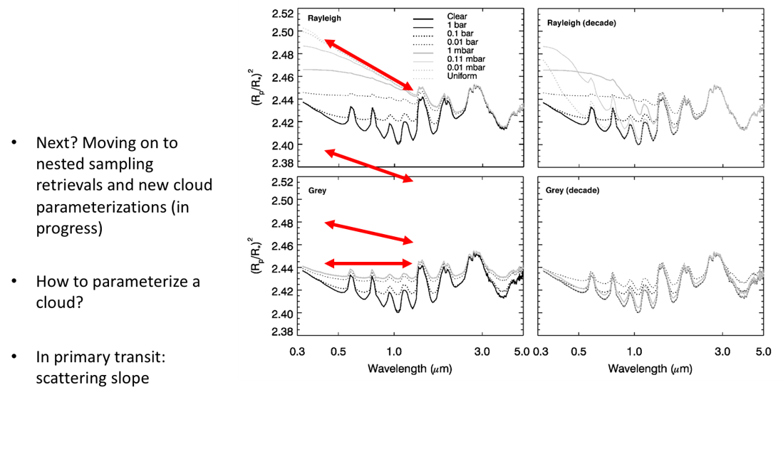

Slide 54
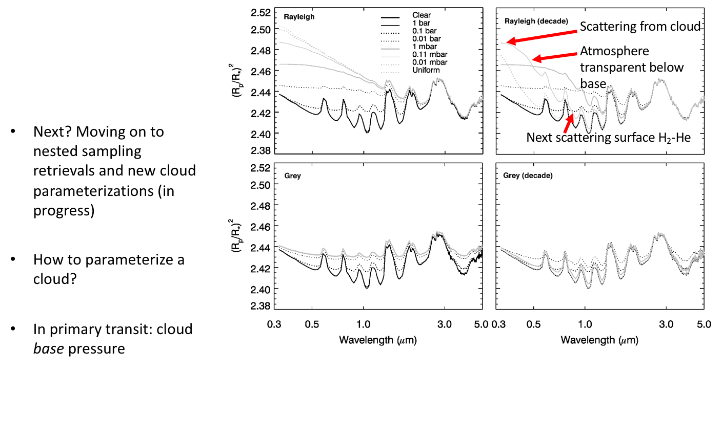

Slide 55
